Slide 1
Chapter-02 Types & Levels of Testing
Prepared By,
Mr.S.H.Sangale

Slide 2
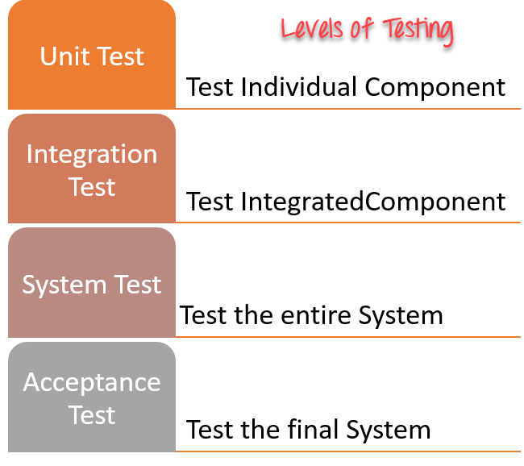
Levels of Testing

Slide 3
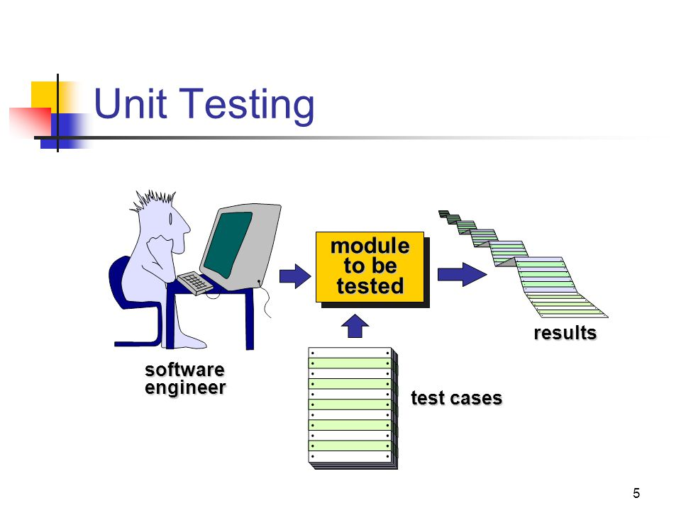

Slide 4
Unit testing
Unit testing involves individually testing unit of code separately to make sure that it works on its own, independent of the other units.
Unit testing is a software development process in which the smallest testable parts of an application, called units, are individually and independently exercised for proper operation.

Slide 5
without affecting the functioning of other units or the program as a whole
Unit testing is an action used to validate that separate units of source code.
It is also called as module test.
It focuses on functionality.
It is done before system integration.
Main goal is to isolate the smallest unit to check whether behave as expected.
It is executed by the Developer.
Before integration each unit is tested separately.

Slide 6
Example: - A function, method, Loop or statement in program is working fine.
Concentrates on the internal processing logic and data structures
Allows errors to be more easily predicted
Concentrates on critical modules and those with high cyclomatic complexity
Unit testing can be time-consuming and tedious.
It helps to produce high quality code

Slide 7
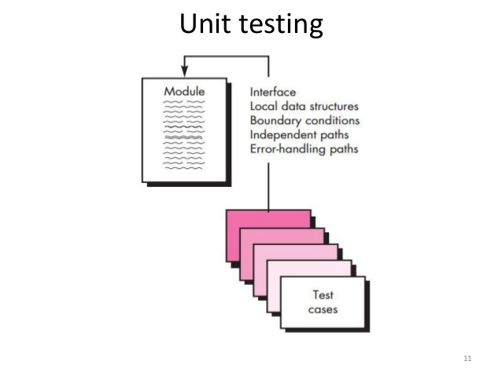
Unit Testing

Slide 8
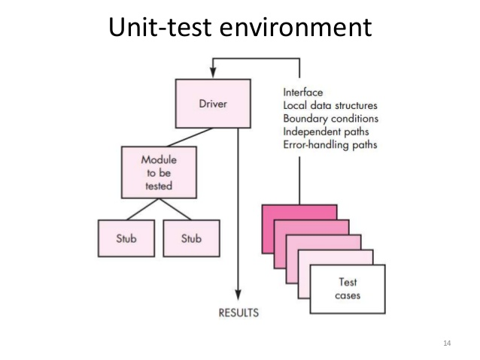
Unit Testing

Slide 9
Targets for Unit Test Cases
Module interface
Ensure that information flows properly into and out of the module
Local data structures
Ensure that data stored temporarily maintains its integrity during all steps in an algorithm execution
Boundary conditions
Ensure that the module operates properly at boundary values established to limit or restrict processing
Independent paths (basis paths)
Paths are exercised to ensure that all statements in a module have been executed at least once
Error handling paths
Ensure that the algorithms respond correctly to specific error conditions

Slide 10
Driver
Drivers are testing tool used to control and operate the software being used.
For Testing modules, it may require some inputs are to be received from another module, this module passes inputs to the module to be tested is not ready and under development.
Suppose you are testing the software that requires large amount of data to enter for execution.
you could replace the keyboard and mouse of system being tested with additional computer acts as a test driver.

Slide 11
‘Driver’ is a piece of software that drives the Unit being tested. I.e. A piece of code that passes test cases to another piece of code
A driver creates necessary ‘Inputs’ required for the Unit and then invokes the Unit
Driver is called component
They control or operate the software being tested
Used in the Bottom –Up Test strategy

Slide 12
stub
Stubs are opposite of driver.
They don’t control or operate the software being tested.
They instead receive or respond to data that the software sends.
Suppose you are testing software that sends data to a printer. To test we can enter data , print it and look at resulting paper but it is inefficient method.

Slide 13
But if you replace printer with another computer that running stub software that could read and interpret the data.
It is much more feasible and quick to test software.
stubs are programs that simulate the behaviors of software components (or modules) that a module undergoing tests depends on.

Slide 14
‘Stub’ is a piece of software that works similar to a unit which is referenced by the Unit being tested, but it is much simpler that the actual unit
dummy modules required to simulate for testing, instead of actual modules. These are called stubs.
i.e. A piece of code that simulates the activity of missing components

Slide 15
A Stub works as a ‘Stand-in’ for the subordinate unit and provides the minimum required behavior for that unit
Stub is calling Component
Used in the Top – Down Testing Strategy

Slide 16
Stubs and drivers are used to replace the missing software and simulate the interface between the software components in a simple manner.
For testing module independently we require stub and driver.
Both are temporary program written for testing purpose.

Slide 17

Integration Testing
It is logical extension of unit testing.
Two units already have been tested are combined and test.
Integrate more than one unit up to whole system.
Idea is to test small pieces and eventually expand the process to test your module with other group.
Integration testing identifies the problem that occur when units are combined.

Slide 18
Decomposition based Testing
There are following strategies
Top Down Integration
Bottom Up Integration
Bi-Directional Integration
Incremental Integration
Non- Incremental Integration

Slide 19
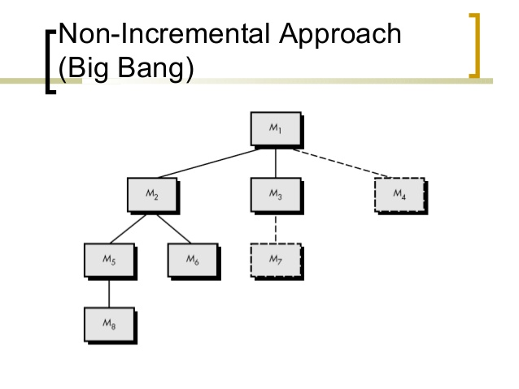
Non-incremental

Slide 20
Non-incremental
All the software units are assembled into the entire program.
This assembly is then tested as a whole from the beginning.
Cause of defects are not easily isolated and corrected.
The non incremental approach is also known as “Big-Bang” testing. This approach is very unfashionable due to the level of risk that one takes in hoping that the system will perform as expected.

Slide 21
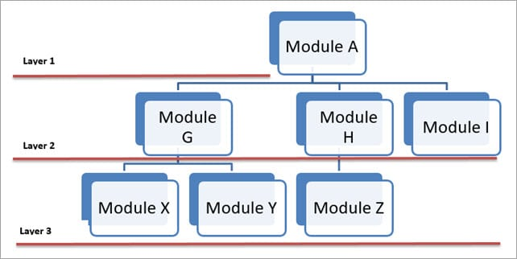
Incremental Integration

Slide 22
Incremental Integration
The program is constructed and tested in small increments by adding a minimum number of components at each interval.
Therefore errors are easier to isolate and correct.
Interfaces are tested completely

Slide 23
Top-down Testing
The top down testing requires highest level module to test and integrated first.
Modules are integrated from the main module to subordinate module.
In Top-down Testing, higher level modules are tested. If lower modules required to make up the system are not yet available then, stubs are used to simulate their activity.

Slide 24
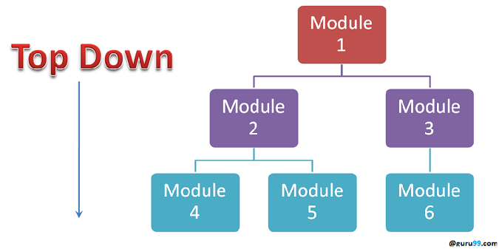

Slide 26
Bottom-up testing
The bottom- up testing requires the lowest level units to be tested and integrated first.
Lowest level sub-module are integrated and test then successively upper level components are added and tested.
In Bottom-up testing, lower level modules are tested. If the higher level modules required to make up the sysused to simulate their tem are not yet available then, drivers are activity.

Slide 27
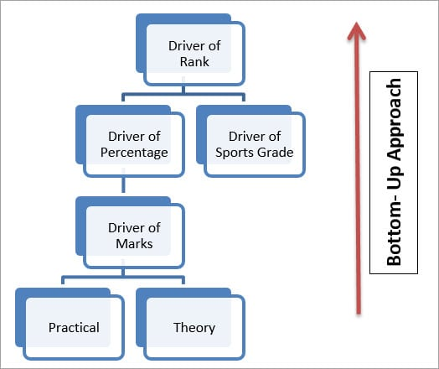

Slide 29
Bi-directional Testing
It is combination of Top down and Bottom up integration testing
Known as sandwich testing.

Slide 31
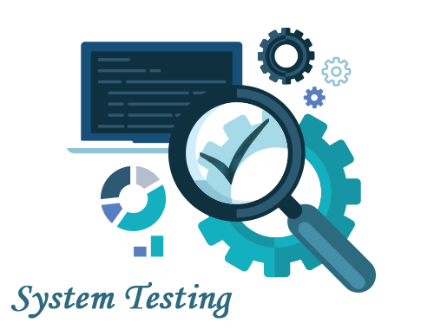
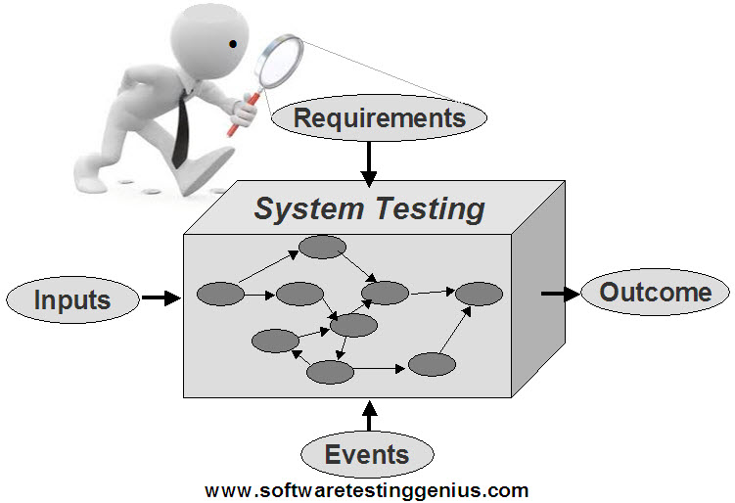
System Testing

Slide 32
System Testing
System Testing (ST) is a black box testing technique performed to evaluate the complete system against specified requirements.
In System testing, the functionalities of the system are tested.
It concentrates on testing the complete system.
Against objectives of the system
In many different environment with various versions and operating systems.
System testing test all components of the system.

Slide 33
Testing the interaction with other parts of the system to validate and verify functional specifications.
Usability testing , Functional testing , performance testing , security testing ,regression testing are used.
System testing should investigate both functional and non-functional requirements of the testing.

Slide 34
Recovery Testing
In software testing, recovery testing is the activity of testing how well an application is able to recover from crashes, hardware failures and other similar problems.
It is done to check how fast and better the application can recover against any type of crash.
Recovery testing is an extension to Error handling testing.
It is also known as reliability testing where test engineer can test whether application can recover from abnormal situation
Ex. During power failure, network disconnect, server down, database disconnect

Slide 35
It is a type of non-functional testing.
Recovery testing is done in order to check how fast and better the application can recover after it has gone through any type of crash or hardware failure etc.
Recovery testing is the forced failure of the software in a variety of ways to verify that recovery is properly performed. For example, when an application is receiving data from a network, unplug the connecting cable. After some time, plug the cable back in and analyze the application’s ability to continue receiving data from the point at which the network connection was broken. Restart the system while a browser has a definite number of sessions and check whether the browser is able to recover all of them or not.

Slide 36
Security testing
It is a type of non-functional testing.
Security testing is basically a type of software testing that’s done to check whether the application or the product is secured or not. It checks to see if the application is vulnerable to attacks, if anyone hack the system or login to the application without any authorization.
It is a process to determine that an information system protects data and maintains functionality as intended.
The security testing is performed to check whether there is any information leakage in the sense by encrypting the application or using wide range of software’s and hardware’s and firewall etc.
Software security is about making software behave in the presence of a malicious attack.
The six basic security concepts that need to be covered by security testing are: confidentiality, integrity, authentication, availability, authorization and non-repudiation.

Slide 37
Performance testing
It is a type of non-functional testing.
Performance testing is testing that is performed, to determine how fast some aspect of a system performs under a particular workload.
It can serve different purposes like it can demonstrate that the system meets performance criteria.
It can compare two systems to find which performs better. Or it can measure what part of the system or workload causes the system to perform badly.
This process can involve quantitative tests done in a lab, such as measuring the response time or the number of MIPS (millions of instructions per second) at which a system functions.
Why to do performance testing:
Improve user experience on sites and web apps
Increase revenue generated from websites
Gather metrics useful for tuning the system
Identify bottlenecks such as database configuration
Determine if a new release is ready for production
Provide reporting to business stakeholders regarding performance against expectations

Slide 38
Load testing
Load testing is a type of non-functional testing.
A load test is type of software testing which is conducted to understand the behavior of the application under a specific expected load.
Load testing is performed to determine a system’s behavior under both normal and at peak conditions.
It helps to identify the maximum operating capacity of an application as well as any bottlenecks and determine which element is causing degradation. E.g. If the number of users are increased then how much CPU, memory will be consumed, what is the network and bandwidth response time.
Load testing can be done under controlled lab conditions to compare the capabilities of different systems or to accurately measure the capabilities of a single system.
Load testing involves simulating real-life user load for the target application. It helps you determine how your application behaves when multiple users hits it simultaneously.
Load testing differs from stress testing, which evaluates the extent to which a system keeps working when subjected to extreme work loads or when some of its hardware or software has been compromised.
The primary goal of load testing is to define the maximum amount of work a system can handle without significant performance degradation.
Examples of load testing include:
Downloading a series of large files from the internet.
Running multiple applications on a computer or server simultaneously.
Assigning many jobs to a printer in a queue.
Subjecting a server to a large amount of traffic.
Writing and reading data to and from a hard disk continuously.

Slide 39
It is a type of non-functional testing.
It involves testing beyond normal operational capacity, often to a breaking point, in order to observe the results.
It is a form of software testing that is used to determine the stability of a given system.
It put greater emphasis on robustness, availability, and error handling under a heavy load, rather than on what would be considered correct behavior under normal circumstances.
The goals of such tests may be to ensure the software does not crash in conditions of insufficient computational resources (such as memory or disk space).

Slide 40
Volume testing
It is a type of non-functional testing.
Volume testing refers to testing a software application or the product with a certain amount of data. E.g., if we want to volume test our application with a specific database size, we need to expand our database to that size and then test the application’s performance on it.
“Volume testing” is a term given and described in Glenford Myers’ The Art of Software Testing, 1979. Here’s his definition: “Subjecting the program to heavy volumes of data. The purpose of volume testing is to show that the program cannot handle the volume of data specified in its objectives” – p. 113.
The purpose of volume testing is to determine system performance with increasing volumes of data in the database.

Slide 41
Volume Testing = Large amounts of data Load Testing = Large amount of users Stress Testing = Too many users, too much data, too little time and too little room

Slide 42
Regression testing
What is Regression testing in software?
Regression testing: During confirmation testing the defect got fixed and that part of the application started working as intended.
But there might be a possibility that the fix may have introduced or uncovered a different defect elsewhere in the software.
The way to detect these ‘unexpected side-effects’ of fixes is to do regression testing.
The purpose of a regression testing is to verify that modifications in the software or the environment have not caused any unintended adverse side effects and that the system still meets its requirements.
Regression testing are mostly automated because in order to fix the defect the same test is carried out again and again
it will be very tedious to do it manually.
Regression tests are executed whenever the software changes, either as a result of fixes or new or changed functionality.

Slide 43
Compatibility testing
Software compatibility testing means checking that your software interacts with and shares information correctly with other software.
Compatibility Testing means checking whether software interacts and shares information correctly with different operating systems, hardware and software configurations available.
This interaction could occur between two programs
simultaneously running on the same computer or even on different computers connected
through the Internet thousands of miles apart

Slide 44
Examples of compatible software are
• Cutting text from a Web page and pasting it into a document opened in your word processor
• Saving accounting data from one spreadsheet program and then loading it into a completely different spreadsheet program
• Having photograph touchup software work correctly on different versions of the same operating system

Slide 46
There are two types of compatibility:
1. Backward compatibility testing: it will work with previous versions of the software.
2. Forward compatibility testing: it will work with Future invented versions of the software.

Slide 47
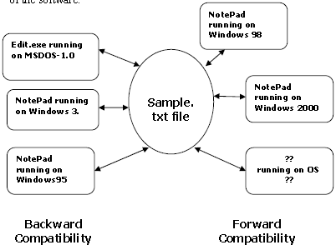

Slide 48
Data Sharing Compatibility
File save and file load
File export and file import
Cut, copy, and paste

Slide 49
Usability Testing:
The means that you use to interact with a software program is called its user interface
seven important traits common to a good UI.
• Follows standards and guidelines
your software follows existing standards and guidelines
• Intuitive
Is the user interface clean, unobtrusive, not busy?
Is the UI organized
Is there excessive functionality?
• Consistent
Shortcut keys and menu selections.
Terminology and naming
• Flexible
Flexible software provides more options and more ways to accomplish
the same task
• Comfortable
Software should look and feel proper
A program should warn users before a critical operation

Slide 50
• Correct
WYSIWYG (what you see is what you get).
• Useful
whether it’s useful
This testing is related to a system’s presentation rather than its functionality. It helps to find human factors or usability problems on the system. To adapt according to the actual work styles rather than forcing the user to adapt according to the software
Usability testing identifies discrepancies between the user interfaces of a product and the human engineering requirements of its potential users.
It tests how easy software easy to us/learn and convenient to the end use.

Slide 51
Acceptance testing
Acceptance testing is a test conducted to determine if the requirements of a specification or contract are met.
The goal of acceptance testing is to establish confidence in the system.
Acceptance testing is most often focused on a validation type testing.
enable the user, customers or other authorized entity to determine whether or not to accept the system.

Slide 52
Types of Acceptance testing
User acceptance testing
This may include factory acceptance testing, i.e. the testing done by factory users before the product or system is moved to its destination site, after which site acceptance testing may be performed by the users at the site.
Operational acceptance testing
Also known as operational readiness testing, this refers to the checking done to a system to ensure that processes and procedures are in place to allow the system to be used and maintained. This may include checks done to back-up facilities, procedures for disaster recovery, training for end users, maintenance procedures, and security procedures.

Slide 53
Contract and regulation acceptance testing
In contract acceptance testing, a system is tested against acceptance criteria as documented in a contract, before the system is accepted. In regulation acceptance testing, a system is tested to ensure it meets governmental, legal and safety standards.
Alpha and Beta testing
Alpha testing takes place at developers' sites, and involves testing of the operational system by internal staff, before it is released to external customers. Beta testing takes place at customers' sites, and involves testing by a group of customers who use the system at their own locations and provide feedback, before the system is released to other customers. The latter is often called “field testing”.

Slide 54
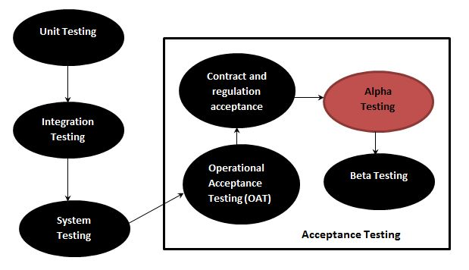

Slide 55
Alpha testing
Alpha testing, the software is tested by in-house developers during which the goal is to catch bugs quickly.
In the second phase of alpha testing, the software is given to the software QA team for additional testing.
Alpha testing is a form of internal acceptance testing, before the beta testing is performed.

Slide 56
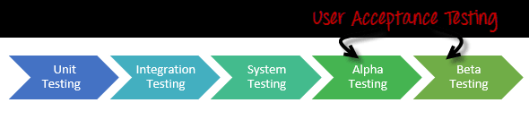
performed to identify all possible issues/bugs before releasing the product to everyday users or public
The focus of this testing is to simulate real users by using blackbox and whitebox techniques.

Slide 57
Beta Testing
Beta Testing of a product is performed by "real users" of the software application in a "real environment" and can be considered as a form of external user acceptance testing.
Beta version of the software is released to a limited number of end-users of the product to obtain feedback on the product quality. Beta testing reduces product failure risks and provides increased quality of the product through customer validation.

Slide 58
It is the final test before shipping a product to the customers.
Direct feedback from customers is a major advantage of Beta Testing.
This testing helps to tests the product in real time environment.

Slide 59
Alpha Testing | Beta Testing
Alpha testing performed by Testers who are usually internal employees of the organization | Beta testing is performed by Clients or End Users who are not employees of the organization
Alpha Testing performed at developer's site | Beta testing is performed at client location or end user of the product
Reliability and security testing are not performed in-depth Alpha Testing | Reliability, Security, Robustness are checked during Beta Testing
Alpha testing involves both the white box and black box techniques | Beta Testing typically uses black box testing
Alpha testing requires lab environment or testing environment | Beta testing doesn't require any lab environment or testing environment. Software is made available to the public and is said to be real time environment

Slide 60
Long execution cycle may be required for Alpha testing | Only few weeks of execution are required for Beta testing
Critical issues or fixes can be addressed by developers immediately in Alpha testing | Most of the issues or feedback is collected from Beta testing will be implemented in future versions of the product
Alpha testing is to ensure the quality of the product before moving to Beta testing | Beta testing also concentrates on quality of the product, but gathers users input on the product and ensures that the product is ready for real time users.

Slide 61
Advantages Beta Testing
Reduces product failure risk via customer validation.
Beta Testing allows a company to test post-launch infrastructure.
Improves product quality via customer feedback
Cost effective compared to similar data gathering methods
Creates goodwill with customers and increases customer satisfaction
Disadvantages Beta Testing
Test Management is an issue. As compared to other testing types which are usually executed inside a company in a controlled environment, beta testing is executed out in the real world where you seldom have control.
Finding the right beta users and maintaining their participation could be a challenge
Advantages of Alpha Testing:
Provides better view about the reliability of the software at an early stage
Helps simulate real time user behavior and environment.
Detect many showstopper or serious errors
Ability to provide early detection of errors with respect to design and functionality
Disadvantages of Alpha Testing:
In depth functionality cannot be tested as software is still under development stage Sometimes developers and testers are dissatisfied with the results of alpha testing

Slide 62
Smoke Testing
Smoke Testing is performed after software build to as certain that the critical functionalities of the program is working fine.
It is executed "before" any detailed functional or regression tests are executed on the software build. The purpose is to reject a badly broken application, so that the QA team does not waste time installing and testing the software application.
In Smoke Testing, the test cases chosen cover the most important functionality or component of the system. The objective is not to perform exhaustive testing, but to verify that the critical functionalities of the system is working fine. For Example a typical smoke test would be - Verify that the application launches successfully, Check that the GUI is responsive ... etc.

Slide 63
what is Sanity Testing?
After receiving a software build, with minor changes in code, or functionality, Sanity testing is performed to ascertain that the bugs have been fixed and no further issues are introduced due to these changes. The goal is to determine that the proposed functionality works roughly as expected. If sanity test fails, the build is rejected to save the time and costs involved in a more rigorous testing.
The objective is "not" to verify thoroughly the new functionality, but to determine that the developer has applied some rationality (sanity) while producing the software. For instance, if your scientific calculator gives the result of 2 + 2 =5! Then, there is no point testing the advanced functionalities like sin 30 + cos 50.

Slide 64
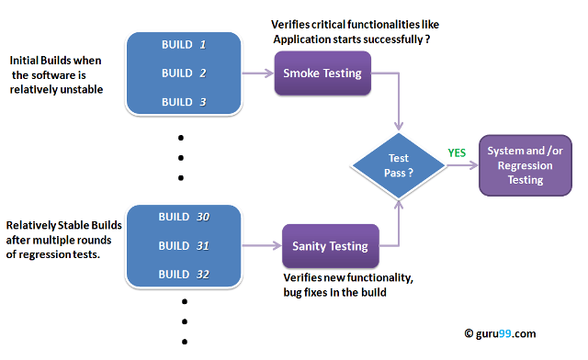

Slide 65
Projects are broadly divided into two types of:
2 tier applications
3 tier applications
CLIENT / SERVER TESTING This type of testing usually done for 2 tier applications (usually developed for LAN) Here we will be having front-end and backend.
The application launched on front-end will be having forms and reports which will be monitoring and manipulating data
E.g: applications developed in VB, VC++, Core Java, C, C++, D2K, PowerBuilder etc., The backend for these applications would be MS Access, SQL Server, Oracle, Sybase, Mysql, Quadbase
The tests performed on these types of applications would be – User interface testing – Manual support testing – Functionality testing – Compatibility testing & configuration testing – Intersystem testing
WEB TESTING

Slide 66
This is done for 3 tier applications (developed for Internet / intranet / xtranet) Here we will be having Browser, web server and DB server.
The applications accessible in browser would be developed in HTML, DHTML, XML, JavaScript etc. (We can monitor through these applications)
Applications for the web server would be developed in Java, ASP, JSP, VBScript, JavaScript, Perl, Cold Fusion, PHP etc. (All the manipulations are done on the web server with the help of these programs developed)
The DBserver would be having oracle, sql server, sybase, mysql etc. (All data is stored in the database available on the DB server)
The tests performed on these types of applications would be – User interface testing – Functionality testing – Security testing – Browser compatibility testing – Load / stress testing – Interoperability testing/intersystem testing – Storage and data volume testing
A web-application is a three-tier application. This has a browser (monitors data) [monitoring is done using html, dhtml, xml, javascript]-> webserver (manipulates data) [manipulations are done using programming languages or scripts like adv java, asp, jsp, vbscript, javascript, perl, coldfusion, php] -> database server (stores data) [data storage and retrieval is done using databases like oracle, sql server, sybase, mysql].

Slide 67
The types of tests, which can be applied on this type of applications, are: 1. User interface testing for validation & user friendliness 2. Functionality testing to validate behaviors, i/p, error handling, o/p, manipulations, services levels, order of functionality, links, content of web page & backend coverage’s 3. Security testing 4. Browser compatibility 5. Load / stress testing 6. Interoperability testing 7. Storage & data volume testing
A client-server application is a two tier application. This has forms & reporting at front-end (monitoring & manipulations are done) [using vb, vc++, core java, c, c++, d2k, power builder etc.,] -> database server at the backend [data storage & retrieval) [using ms access, sql server, oracle, sybase, mysql, quadbase etc.,]
The tests performed on these applications would be 1. User interface testing 2. Manual support testing 3. Functionality testing 4. Compatibility testing 5. Intersystem testing Some more points to clear the difference between client server, web and desktop applications:
Desktop application: 1. Application runs in single memory (Front end and Back end in one place) 2. Single user only

Slide 68
Client- Server Testing
a client, a server, and network
Request
Client
Server
Network
Result
Client machine
Server machine

Slide 69
Client-Server Testing
Client-server software requires specific forms of testing to prevent or predict fatal errors. Servers go down, records lock, I/O (Input/Output) errors and lost messages can really cut into the benefits of adopting this network technology.
Testing addresses system performance and scalability by understanding how systems respond to increased workloads and what causes them to fail.

Slide 70
Types of architecture in client –Server computing
1-tier architecture.
2-tier architecture.
3-tier architecture.

Slide 71
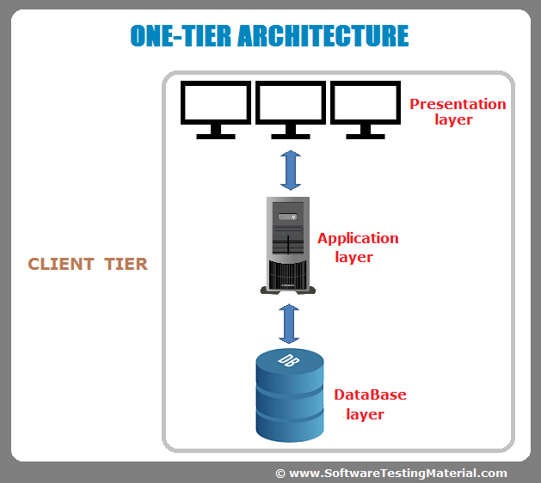
1-tier architecture.
In this category of client-server setting, the user interface, marketing logic and data logic are present in the same system.

Slide 72
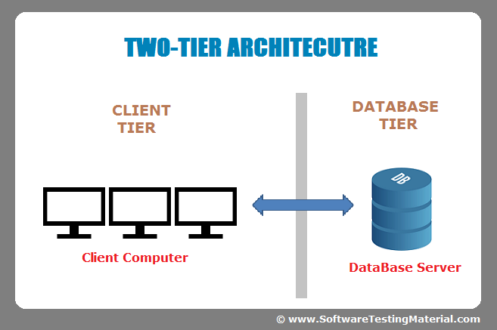
2-tier architecture.
A two-tier architecture is a software architecture in which a presentation layer or interface runs on a client, and a data layer or data structure gets stored on a server. Separating these two components into different locations represents a two-tier architecture, as opposed to a single-tier architecture.

Slide 73
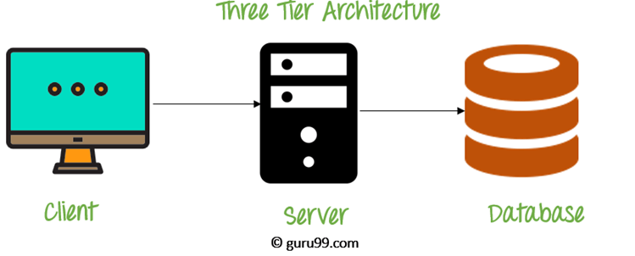
3-tier architecture.
A three-tier architecture is a client-server architecture in which the functional process logic, data access, computer data storage and user interface are developed and maintained as independent modules on separate platforms.

Slide 74
Client Side testing
GUI Testing
Cross-Platform nature
Event-driven nature

Slide 75
Server side Testing.
Volume testing
Stress testing
Performance testing
Data testing
Security testing

